Slide 1
Learning Objective
CFU
What will we learn today?
I will be able to solve simultaneous equations
CFU
How will you know that you are successful?
Success Criteria
At the end of the lesson, I will be able to:
Solve simultaneous equations graphically
Solve simultaneous equations using the substitution method
Solve simultaneous equations using the elimination method

Slide 2
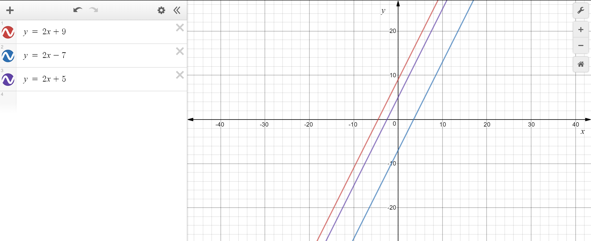
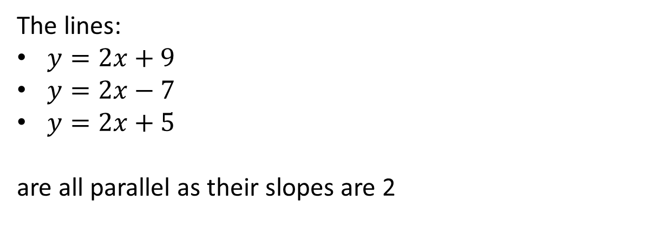
Activating Prior Knowledge
Lines that are parallel to each other
will never intersect
have the same slope (gradient)
The lines:
$y=2x+9$
$y=2x−7$
$y=2x+5$
are all parallel as their slopes are 2

Slide 3
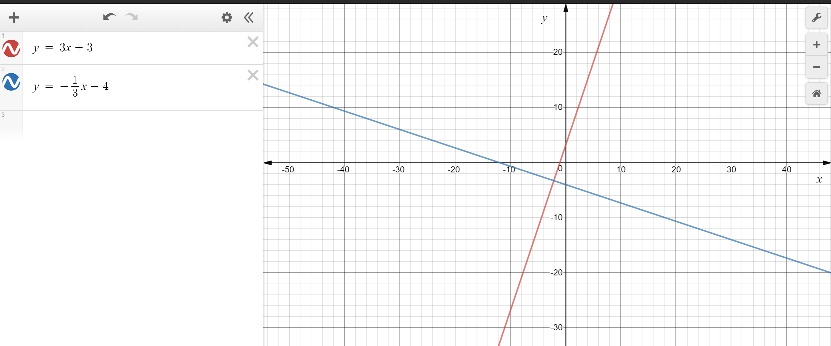
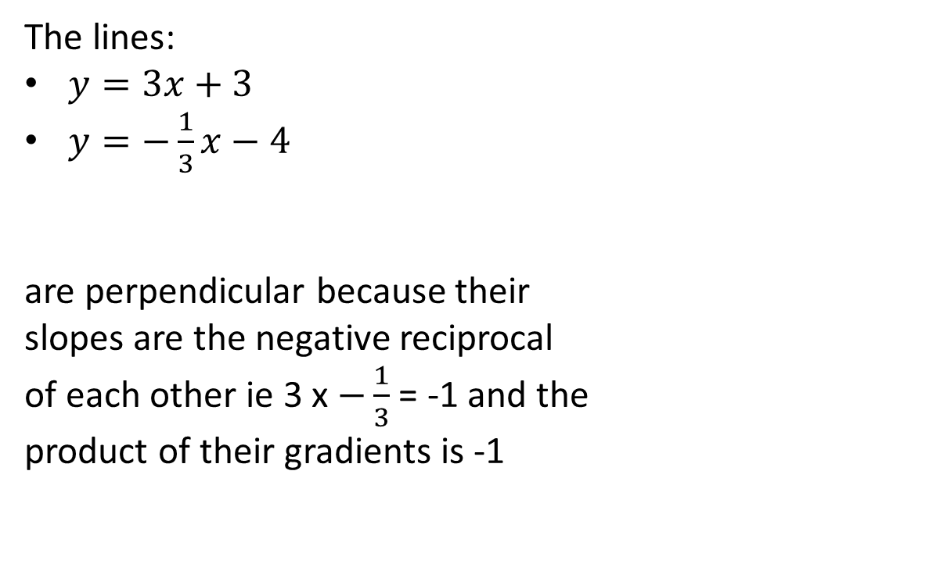
Activating Prior Knowledge
Lines that are perpendicular to each other
intersect at 90°
have negative reciprocal slopes (gradients)
have -1 as the product (multiplying) of their slopes
The lines:
$y=3x+3$
$y=−\frac{1}{3}x−4$
are perpendicular because their
slopes are the negative reciprocal
of each other ie 3 x $−\frac{1}{3}$ = -1 and the
product of their gradients is -1

Slide 4
Concept Development
Suppose the Morris family, consisting of 2 adults and 2 children, goes to the cinema. They pay $48 for their tickets.
The Smith family, consisting of 1 adult and 3 children also goes to the cinema. They pay $40 for their ticket.
Determine the ticket price for an adult and for a child.
Step 1: Define your variables
Let $a$ be the price of the adult tickets
Let $b$ be the price of the children tickets
Step 2: Form an equation
$$2a+2c=48$$
$$a+3c=40$$
We now have 2 equations and 2 variables (unknowns).
These are called simultaneous equations.

Slide 5
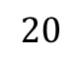
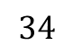
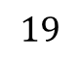
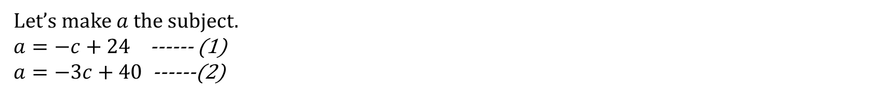
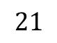
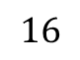
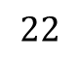
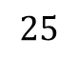
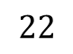
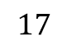
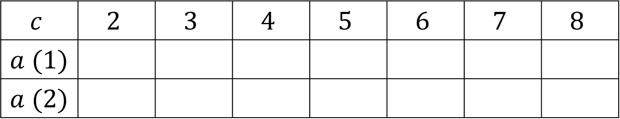
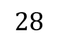
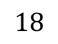
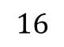
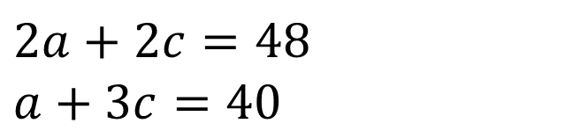
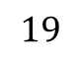
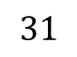
Concept Development
Suppose the Morris family, consisting of 2 adults and 2 children, goes to the cinema. They pay $48 for their tickets.
The Smith family, consisting of 1 adult and 3 children also goes to the cinema. They pay $40 for their ticket.
Determine the ticket price for an adult and for a child.
$$2a+2c=48$$
$$a+3c=40$$
To solve this problem, we need to find the values of $a$ and $c$ that make the both equations true.
Let’s make $a$ the subject.
$a=−c+24$ ------ (1)
$a=−3c+40$ ------(2)
Complete the table of values
$$c$$ | $$2$$ | $$3$$ | $$4$$ | $$5$$ | $$6$$ | $$7$$ | $$8$$
$a (1)$
$a (2)$
$$22$$
$$21$$
$$20$$
$$19$$
$$18$$
$$17$$
$$16$$
$$34$$
$$31$$
$$28$$
$$25$$
$$22$$
$$19$$
$$16$$
At what coordinates do they have the same coordinates?

Slide 6
Concept Development
Any two linear graphs will intersect if the lines are not parallel
At the point of intersection, each line will have the same $x−$ and $y−$ coordinates
Simultaneous linear equations can be solved:
Graphically – draw the graph of both equations and find their point of intersection
Using elimination – add or subtract to eliminate (get rid of) one variable
Using substitution – substitute (put in the place of) a variable from
one equation in to the second equation

Slide 7
Skill Development – solve graphically
Solving Graphically

Slide 8
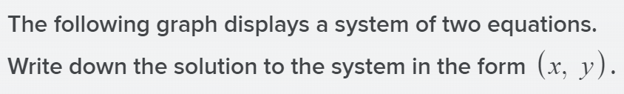
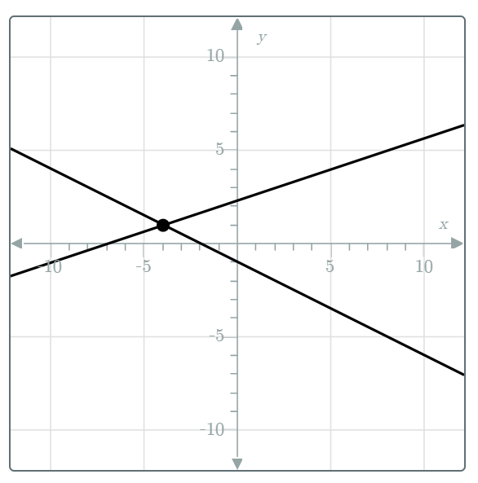
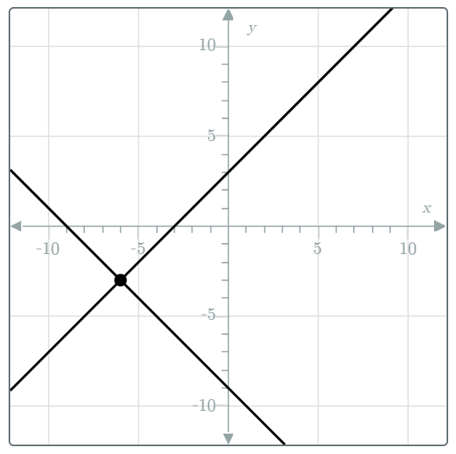
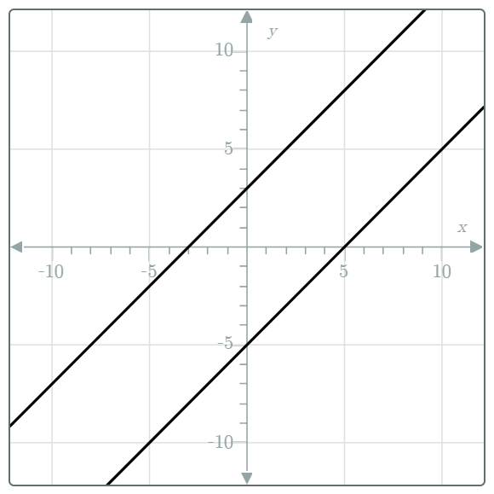
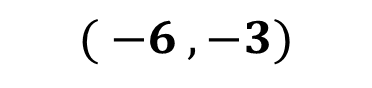
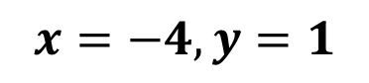

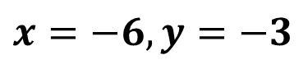
Skill Closure
$$( −4 , 1)$$
$$( −6 , −3)$$
There is no solution as the lines are parallel.
$$x=−4,y=1$$
$$x=−6,y=−3$$

Slide 9
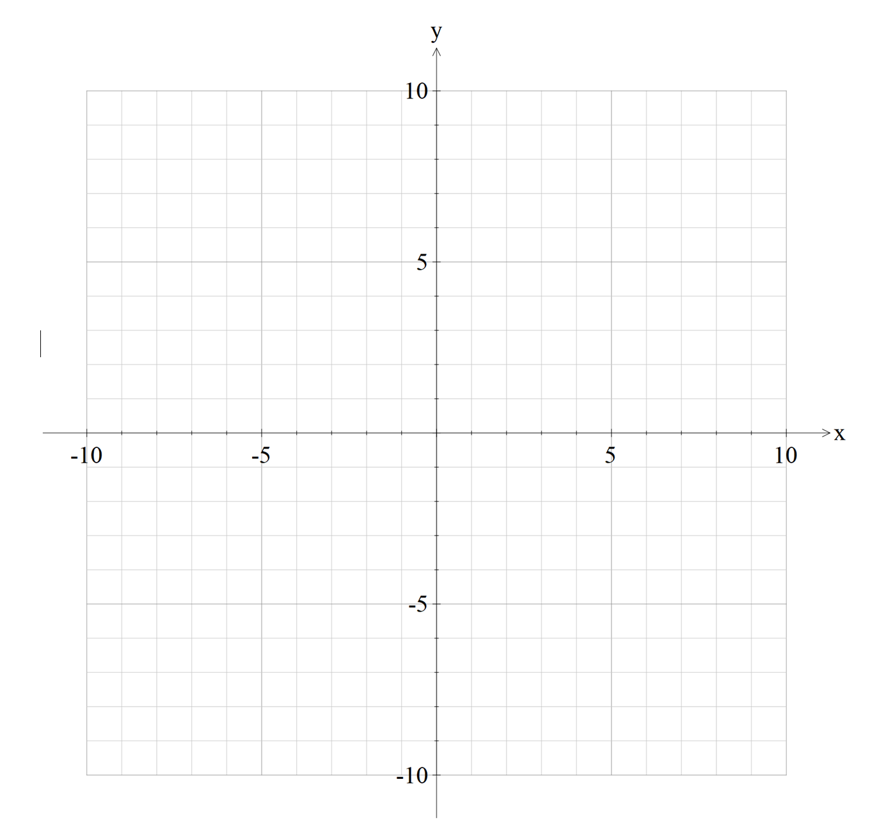
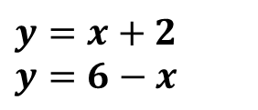
Skill Development – solve graphically
Solve each of the following pairs of simultaneous equations graphically
$$y=x+2$$
$$y=6−x$$
1. Sketch both graphs
2. Find the point of intersection
The point of intersection is (2 , 4)

Slide 10
Skill Development – solve by elimination
Solving by elimination

Slide 11
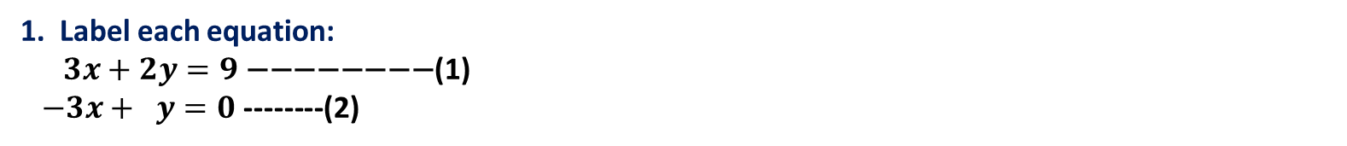
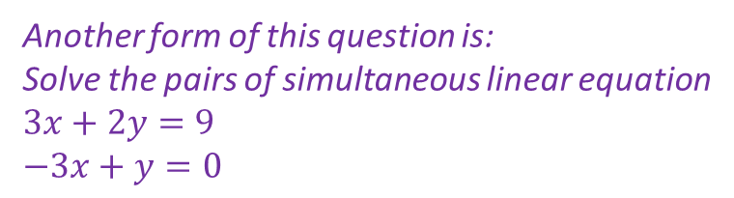
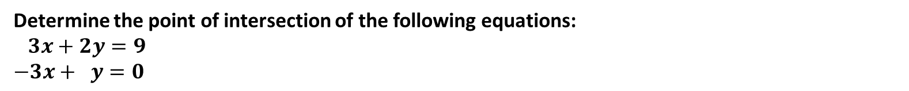
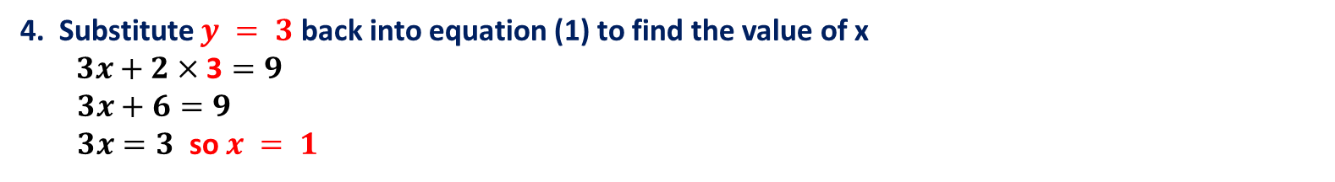
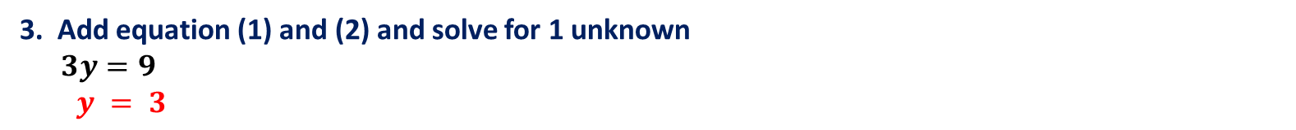
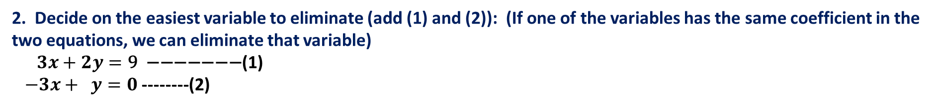
Guided Practice – solve using elimination
Determine the point of intersection of the following equations:
$$3x+2y=9$$
$$−3x+ y=0$$
Another form of this question is:
Solve the pairs of simultaneous linear equation
$$3x+2y=9$$
$$−3x+y=0$$
1. Label each equation:
$$3x+2y=9 \text{−−−−−−−−}\text{(}\text{1}\text{)}$$
$−3x+ y=0$ --------(2)
2. Decide on the easiest variable to eliminate (add (1) and (2)): (If one of the variables has the same coefficient in the two equations, we can eliminate that variable)
$$3x+2y=\text{9 −−−−−−−}\text{(}\text{1}\text{)}$$
$−3x+ y=0$ --------(2)
3. Add equation (1) and (2) and solve for 1 unknown
$3y=9$
$y = 3$
4. Substitute $y = 3$back into equation (1) to find the value of x
$3x+2×\text{3}=9$
$3x+6=9$
$3x=3$ so $x = 1$
5. Substitute $x$= 1 and $y = 3$into equation (2) now to check it works
6. The point of intersection is (1 , 3)

Slide 12
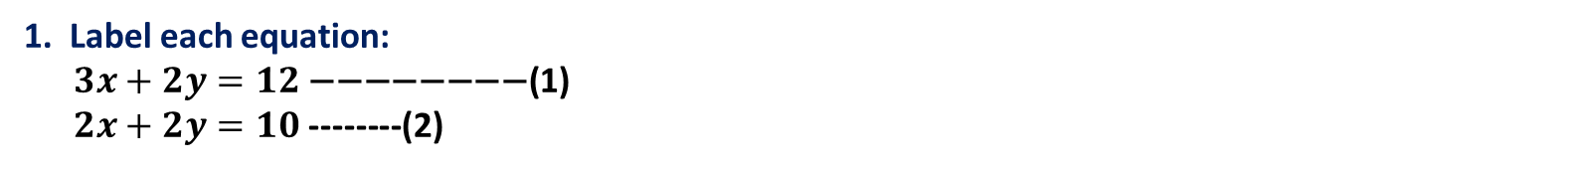
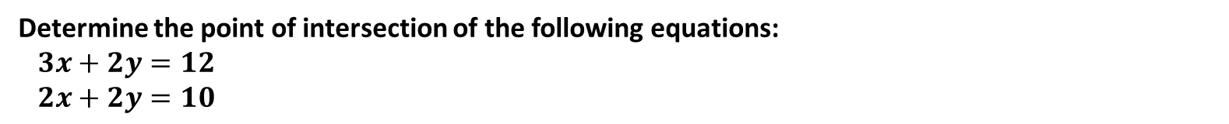
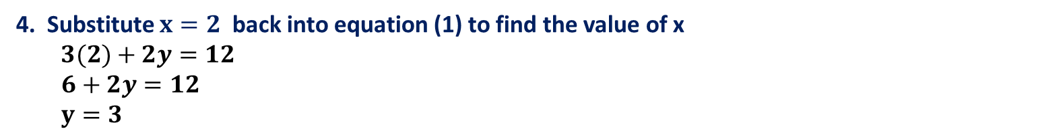

Guided Practice – solve using elimination
Determine the point of intersection of the following equations:
$$3x+2y=12$$
$$2x+2y=10$$
1. Label each equation:
$$3x+2y=12 \text{−−−−−−−−}\text{(}\text{1}\text{)}$$
$2x+2y=10$ --------(2)
2. Decide on the easiest variable to eliminate (add (1) and (2)): (If one of the variables has the same coefficient in the two equations, we can eliminate that variable)
$$3x+2y=\text{12 −−−−−−−}\text{(}\text{1}\text{)}$$
$2x+2y=10$ --------(2)
3. Subtract equation (2) from (1) and solve for 1 unknown
$x=2$
4. Substitute $x=2$back into equation (1) to find the value of x
$3(2)+2y=12$
$6+2y=12$
$y=3$
5. Substitute $x=2$ and $y =3$into equation (2) now to check it works
6. The point of intersection is (2 , 3)

Slide 13

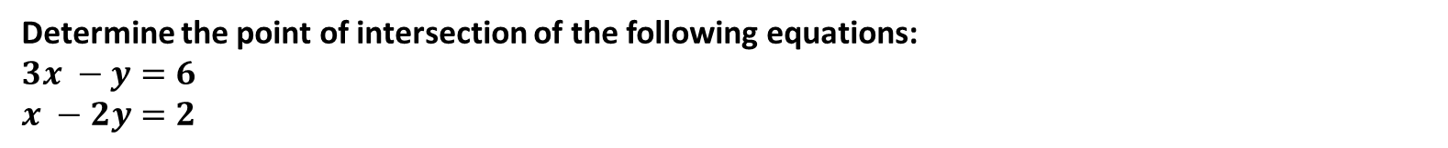
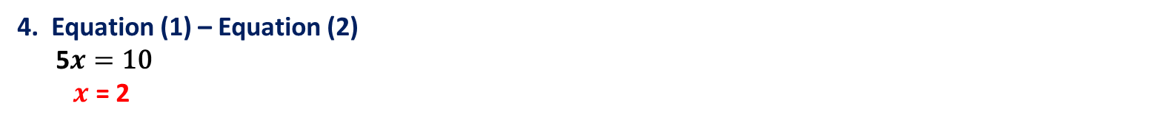
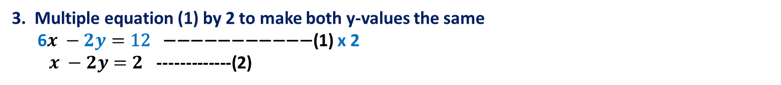
Skill Development – solve using elimination
Determine the point of intersection of the following equations:
$$3x −y=6$$
$$x −2y=2$$
1. Label each equation:
$$3x −y=6\text{ −−−−−−−−−− }\text{(}\text{1}\text{)}$$
$x −2y=2$ ----------- (2)
2. If the variables do not have the same coefficient, consider what the you can multiply to make either coefficient the same.
3. Multiple equation (1) by 2 to make both y-values the same
6$x −2y=\text{12}\text{ −−−−−−−−−−−}\text{(}\text{1}\text{)}$ x 2
$x −2y=2$ -------------(2)
4. Equation (1) – Equation (2)
5$x=\text{10}$
$x$= 2
5. Substitute x = 2 back into equation (1) to find the value of y
$3 (2) −y=6$ which gives $y = 0$
6. Substitute $x$= 2 and $y = 0$into equation (2) now to check it works
7. The point of intersection is (2 , 0)

Slide 14

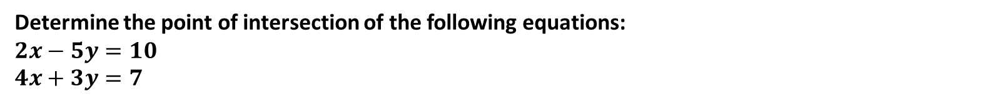
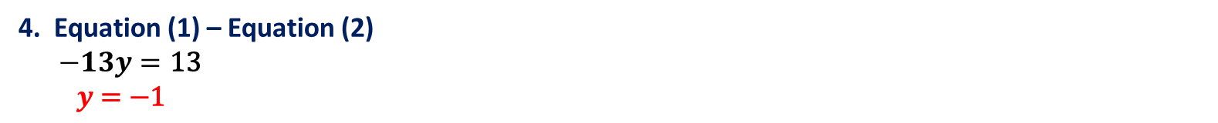
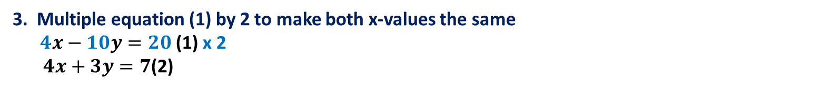
Skill Development – solve using elimination
Determine the point of intersection of the following equations:
$$2x−5y=10$$
$$4x+3y=7$$
1. Label each equation:
$$2x−5\text{y}\text{=10 −−−−−−−−−−−− }\text{(}\text{1}\text{)}$$
$4x+3y=7$ ------------- (2)
2. If the variables do not have the same coefficient, consider what the you can multiply to make either coefficient the same.
3. Multiple equation (1) by 2 to make both x-values the same
$4x−10y=20 \text{(}\text{1}\text{)}$ x 2
$4x+3y=7$(2)
4. Equation (1) – Equation (2)
$−13y=\text{13}$
$y \text{= −1 }$
5. Substitute y = -1 back into equation (1) to find the value of x
$2x−5(−1)=10$ which gives $y=2.5$
6. Substitute $x=2.5$ and y = -1 into equation (2) now to check it works
7. The point of intersection is (2 , 0)

Slide 15
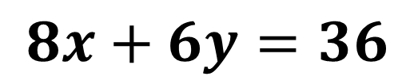


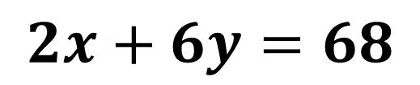
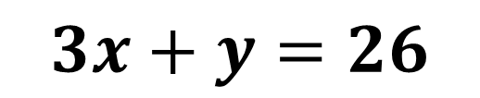

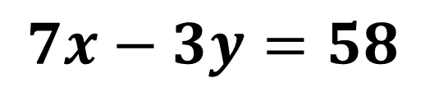
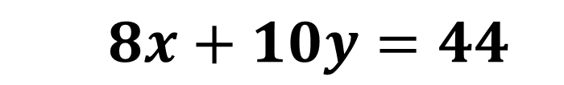
Skill Closure
Would we need to add or subtract these pairs of
simultaneous equations to eliminate a variable?
$$2x+6y=68$$
$$7x−3y=58$$
$2x+4y=46$
$5x+3y=62$
SAME SIGNS! SUBTRACT!
DIFFERENT SIGNS! ADD!
$$3x+y=26$$
$$8x+6y=36$$
$9x−y=58$
$8x+10y=44$
DIFFERENT SIGNS! ADD!
SAME SIGNS! SUBTRACT!

Slide 16
Summary – Elimination method
Check that one of the variables will be eliminated when equations are added or subtracted; You may need to first multiply one or both of the equations by an integer so that this can be achieved.
Add or subtract the two equations to form a new equation containing only one variable.
Solve for the unknown
Substitute value to original equations to solve for the other unknown

Slide 17
Skill Development – solve by substitution
Solving by substitution

Slide 18




Skill Development – solve using substitution
Solve each of the following pairs of simultaneous equations by the substitution method:
$$y=2x$$
$$x+5y=22$$
1. Label each equation:
$$y=2x\text{ −−−−−−−−−}\text{(}\text{1}\text{)}$$
$x+5y=22$ ----------(2)
2. Make one of the variables the subject in one of the equation
$$y=2x\text{ −−−−−−−−−}\text{(}\text{1}\text{)}$$
$x+5y=22$ ----------(2)
3. Substitute $y = 2x$(from equation 1) into (equation 2) in the place of $y$
$x+5(2x)=22$ (2)
$$x+10x=22$$
$11x=22$ so $x$ = 2
4. Substitute $x = 2$back into equation (1) to find the value of y
$y=2(2)$ which gives $y = 4$
5. Substitute $x$= 2 and $y = 4$into equation (2) now to check it works
6. The point of intersection is (2 , 4)

Slide 19





Guided Practice – solve using substitution
Determine the point of intersection of the following equations:
$$x=2y−19$$
$$y=−3x+6$$
1. Label each equation:
$$x=2y−19 \text{(}\text{1}\text{)}$$
$y=−3x+6$(2)
2. Decide on the easiest variable to make as the subject ( x on equation (1)):
$$x=2y−19 \text{(}\text{1}\text{)}$$
$y=−3x+6$ (2)
3. Substitute x=2y-19 from equation (1) into equation (2)
$y=−3\left(2y−19\right)+6$
$$y=−6y+57+6, y+6y=63 7y=63$$
$y = 9$
4. Substitute y = 9 back into equation (1) to find the value of x
$x=2\left(9\right)−19$
$x=−1$so $x=−1$
5. Substitute $x$= -1 and $y = 9$into equation (1) now to check it works
6. The point of intersection is (-1 , 9)

Slide 20




Guided Practice – solve using substitution
Determine the point of intersection of the following equations:
$$3x+2y=9$$
$$−3x+ y=0$$
1. Label each equation:
$$3x+2y=9 \text{(}\text{1}\text{)}$$
$−3x+ y=0$ (2)
2. Decide on the easiest variable to make as the subject ( y on equation (2)):
$$3x+2y=\text{9 }\text{(}\text{1}\text{)}$$
$y=3x$ (2)
3. Substitute y=3x from equation (2) into equation (1)
$3x+2\left(3x\right)=9$
$$9x=9,$$
x = 1
4. Substitute x = 1 back into equation (2) to find the value of y
$y=3\left(1\right)$
$y=3$ so y = 3
5. Substitute $x$= 1 and y = 3 into equation (2) now to check it works
6. The point of intersection is (1 , 3)

Slide 21

Summary – Substitution method
Make one variable the subject (for example: $y$)
Substitute expression for $y$ into the other equation
Simplify and solve for $x$
Substitute value to original equations to solve for $y$

Slide 22
Skill Development – solve by ClassPad
Solving by ClassPad

Slide 23





Guided Practice – solve using substitution
Determine the solution of the following equations:
$$3x+2y=9$$
$$−3x+ y=0$$
Solving algebraically in ClassPad
Solving graphically in ClassPad

Slide 24
Skill Development – solving worded problems
Worded Problems

Slide 25

Skill Development
Example : Find two numbers with a sum of 129 and a difference of 35.
Define your variables (for example: $x,y$)
Form the equations using your variables
Choose an appropriate method (elimination/substitution) to solve for one variable
Substitute value to original equations to solve for second variable

Slide 26
Guided Practice
Find two numbers with a sum of 129 and a difference of 35.

Slide 27
Guided Practice
Find two numbers with a mean of 10 and a difference of 4

Slide 28
1000 tickets were sold. Adult tickets cost $8.50, children's cost $4.50, and a total of $7300 was collected. How many tickets of each kind were sold?
Guided Practice

Slide 29
Mr and Mrs Smith take their five children to the cinema. The total cost is $138. Mr and Mrs Jones take three children to the cinema. Grandma Jones decides to come which brings the total cost to $117. The movies have a special on for the adult tickets. What is the cost of an adult and child ticket?
Guided Practice

Slide 30
Independent Practice
Complete Ex 1C and 1D

